Slide 1
Current Affair
Ban of Chinese apps in India
Pratik Pingale
19CO056

Slide 2
59 Chinese Apps banned on 24 July
The Government of India has banned 59 Chinese mobile applications, including top social media platforms such as TikTok, Helo and WeChat, to counter the threat posed by these applications to the country’s “sovereignty and security”.
In a press release, the govt said the applications are engaged in activities “prejudicial to sovereignty and integrity of India, defence of India, security of state and public order.” The ban has been imposed under Section 69A of the Information Technology Act read with relevant provisions of the Information Technology (Procedure and Safeguards for Blocking of Access of Information by Public) Rules 2009, it said.

Slide 3
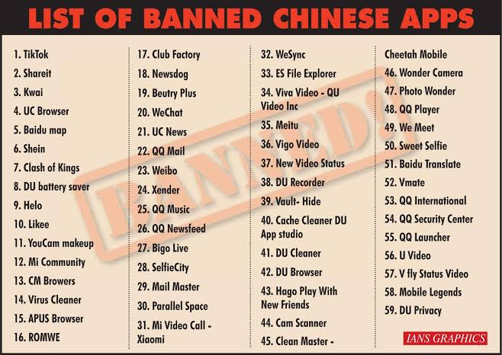
List of 59 banned apps

Slide 4
47 Chinese Apps banned on 27 July
The 47 apps that have been banned by the latest decision of the government were operating as the clones of the 59 apps that were banned last month, according to a tweet posted by DD News.
The decision to ban the apps was taken during a security review meeting of the Telecom Ministry. The government is yet to release the full list of banned Chinese apps.
The banned clone apps include Tiktok Lite, Helo Lite, SHAREit Lite, BIGO LIVE Lite and VFY Lite.

Slide 5
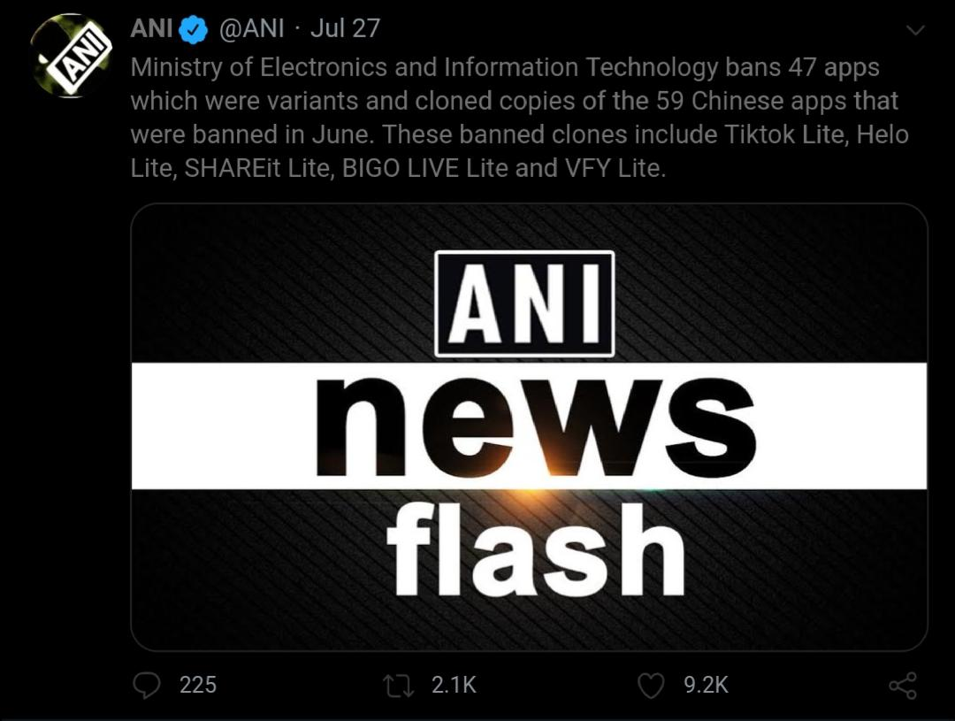
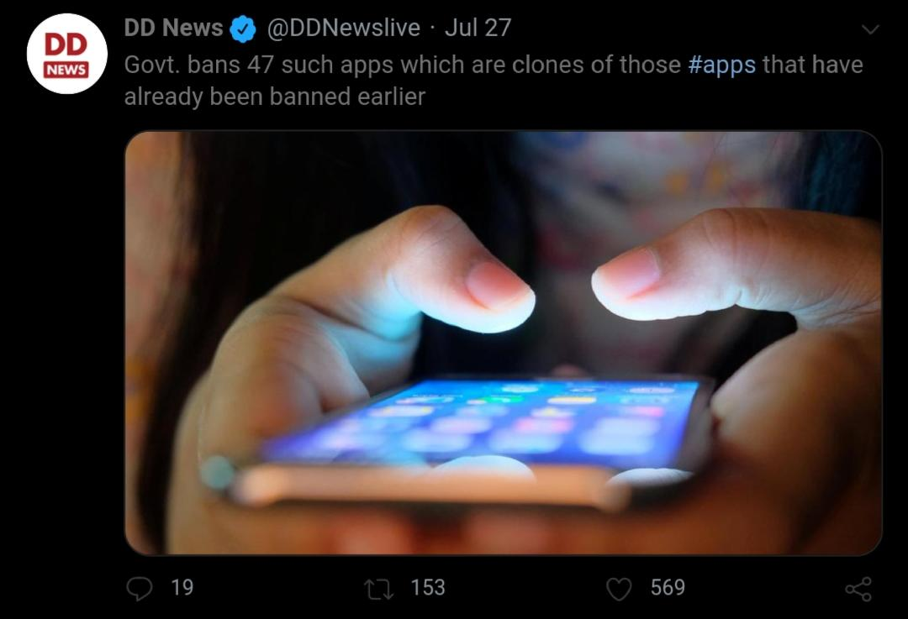
Official tweet from ani and dd news

Slide 6
275 more apps under radar including PUBG
The Indian government is also investigating 275 more apps for possible violations of national security and user privacy. The apps under radar include one of India's top gaming app, PUBG.
A spokesperson for the union home ministry did not respond to queries from ET on the developments. However, official sources said reviews aimed at identifying more Chinese apps and their funding is underway. “Some of these apps have been red-flagged due to security reasons while others have been listed for violation of data sharing and privacy concerns,” an official explained.

Slide 7
Thank you

